Slide 1
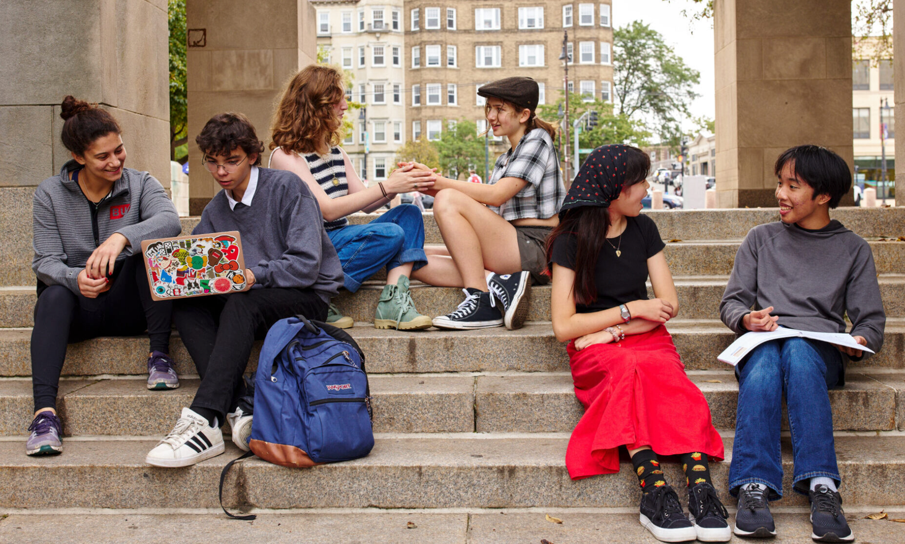
BUA Student
Organization
Orientation
Expectations, Policies, and Resources for Clubs, Affinity Groups , and Alliance Groups
Notes:
The purpose of this orientation is to ensure all student leaders of organization understand the policies and learn about to access resources for their groups. These policies apply to clubs, affinity groups, and alliance groups at BUA.

Slide 2
01
Can My Group Be a BUA Organization?
1
A clear purpose aligned with BUA’s mission
2
A meaningful contribution to the BUA community
3
Regular meetings and year-round activity; take attendance
4
Clear student leadership — each student may lead no more than 2 organizations
5
A purpose distinct from existing organizations
BUA • 2026
Notes:
BUA orgs are defined by 5 guidelines.
1. All BUA orgs must have a clear purpose that aligns with BUA’s mission. Say you love plants and you want to request a club where you sit around with your friends and talk about plants. That alone will not get your group approved by BUA standards. If you plan to teach your members about gardening and host a planting event youre likely to get approved.
2. All BUA orgs must contribute something meaningful to the BUA community. That can be big or small. You might consider hosting gardening lessons, and a big school planting event.
3. Your group must meet regularly, once a week, once every two weeks, once a month, or on another consistent schedule, and you must remain active the whole year.
a. Your group must take attendance on club hub to show that there is interest in your group continuing. If you haven't met in the first few weeks of school, after the activity fair, then your group no longer exists. You will show that your group has met by listing group meetings and tracking attendance on club hub.
4. It must have clear student leadership, It must have clear student leadership, which is what you are taking responsibility for here. Note, in order to support club success, you are limited to leading two orgs. This way, you can prioritize it in your schedule and be dedicated. You are welcome to be a member of however many orgs you’d like.
5. Your group must have a purpose that is meaningfully different from an existing organization.
a. For example say you want to start a Crocheting Club. BUA already has a knitting and fiber arts club. So even if you say you want to only be crocheting, it is not different enough from a club that already exists and I would suggest you join that club and try to get more involved than a general member so you can emphasize crocheting.

Slide 3
02
Leadership expectations
organize and run
meetings
track meetings and
attendance on Club Hub
engage your
members
deliver
on your mission
Meet weekly, biweekly, or monthly.
Groups inactive after the first weeks following the Activity Fair lose organization status.
BUA • 2026
Notes:
Leadership includes organizing meetings, communicating with members, taking attendance, and ensuring you meet the mission of your club and BUA club expectations

Slide 4
04
When does your group need an advisor?
An advisor is required if you...
Ask!
Request a budget
Attend conferences or competitions
Host groups or guests
Discuss potentially sensitive topics
Each year, you must ask your advisor, in person, if they can commit to your group. Your group goals change each year and they need to be able to support you in those goals.
You may choose to have an advisor even if you don’t require the above resources
advisors may support up to 3 groups per year
BUA • 2026
Notes:
2. Advisor: If your group would like to request a budget, attend a conference or competition, host any groups or guest speakers, or if you will discuss potentially sensitive topics, then you need an advisor. You must re-ask your advisor and have them confirm it on club hub each year. Your groups goals change each year, and your advisor's commitments at school change each year, so you need to check in to make sure they have the bandwidth for whatever goals you're thinking about, and they align with them. Keep in mind that advisors are permitted to advise up to three groups per school year. You may also have an advisor even if one isn't required

Slide 5
05
Make meetings easy to find and easy to join
1 FIND A TIME
2 CONFIRM A SPACE
3 PUBLISH IT
Choose a regular meeting time that works for your leaders ahead of the club fair.
Ask a teacher if you can use their room.
Add the time and location to Club Hub and list it at the activity fair.
BUA • 2026
Notes:
3. Meeting time: You need to find a meeting time and add it to your club hub page. Be sure to confirm a meeting space with a teacher and list that on club hub, too.

Slide 6
03
Club Hub is your organization’s home base
1
Use the calendar to schedule meetings and events
2
Share announcements
3
Take attendance
4
A *new* group chat function
5
Use of other social media accounts is not permitted
BUA • 2026
Notes:
1. Club Hub: Club Hub is BUA’s platform for all your student org-related needs. You will take attendance, post announcements, and create events on Club Hub. This year, they have added a chat feature that you are also permitted to use! All group communications should be shared through Club Hub. This way, students know where they can find information about what is happening in a group that they are already part of or are considering joining. Clubs, affinity groups, and alliance groups are not allowed to create or maintain social media accounts.

Slide 7


07
Post with care
8.5 × 11
Posters are for special events only.
YES: bulletin boards, lockers, and windows
NO: doors or walls. Noncompliant posters will be removed.
BUA • 2026
Notes:
5. Groups are permitted to put up posters to advertise special events. Posters must be 8.5 × 11 and can only go in designated spaces. Posters are allowed on designated boards ((1) in the back stair well, (2) by the side door, (3) and on the second floor by the corner classroom facing Storrow drive), lockers, and windows; Posters are not allowed on doors or walls and will be removed. Any posters posted on the walls or wood of doors will be removed. The tape damages the wall paint and wood.

Slide 8
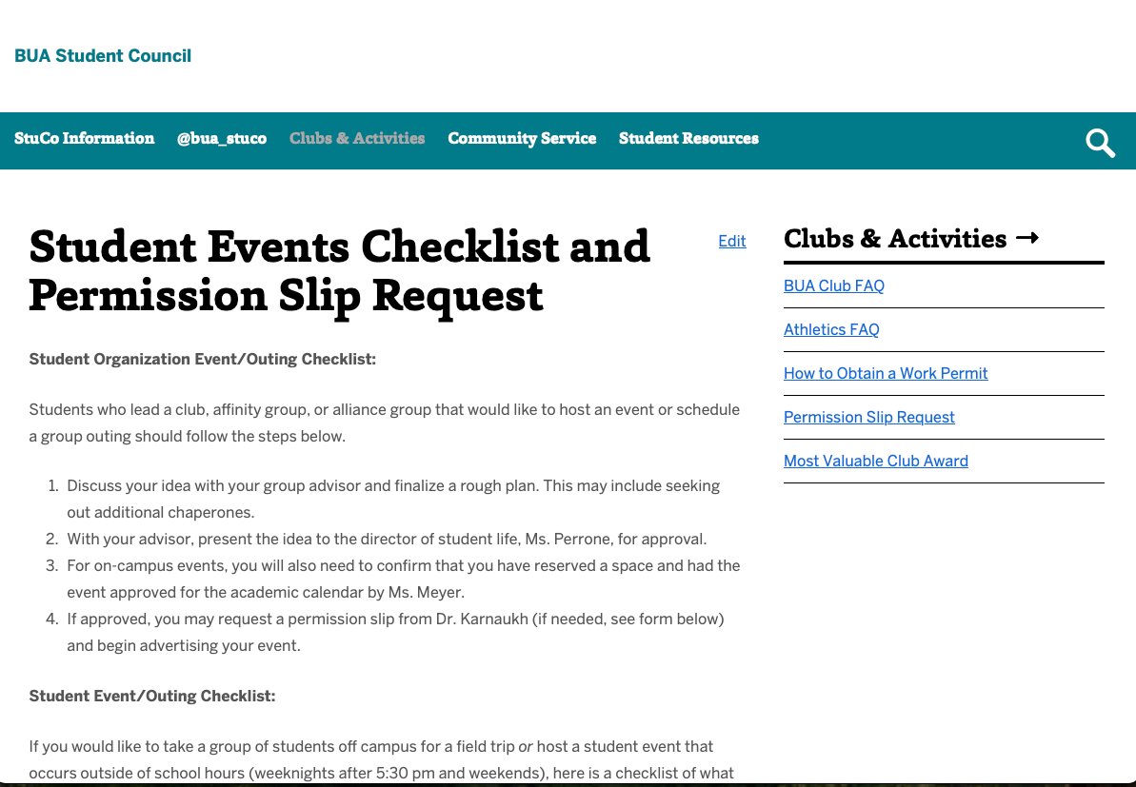
07
Events and outings
2 WEEKS IN ADVANCE
BUA • 2026
Notes:
6. If you have an advisor and you would like to host an event the first person you should talk to is your advisor! If it will be an all school event or something that requires significant resources like booking spaces, catering, or requires a chaperone, you should reach out to me with your rough plan. I will determine if the event is feasible and connect you with the right people to move forward. If you plan to go on a off-campus outing, you need to complete a permission slip request through the student council website at least two weeks in advance. That includes confirming chaperones.

Slide 9
08
How do I get approved?
The application process must be completed before the Activity Fair.
Apply on
Club Hub*
Watch + score
100% on the
policy quiz
Reviewed and approved on a rolling basis
Set up your Club Hub Page
Host a booth at the activity fair
*if you re-registered and were approved in the spring, you have already done this step!
**details to follow when you are approved
Details for requesting a budget will be shared after the activity fair.
BUA • 2026
Notes:
1. Your group must be approved before the activity fair in order to be permitted to attend.
2. 1. Complete Club Hub application
2. Every leader needs to Watch orientation + earn 100% on quiz (all leaders)
3. BUA reviews your application → approved → eligible for Activity Fair
3. Once approved, I’ll send group leaders an email with details about how to prepare for the fair.
4. In rare instances, a club may be approved after this initial club process.
5. After the Activity Fair, groups that indicate in the policy quiz that they would like to request a budget will receive a message on Club Hub with the request details.

Slide 10
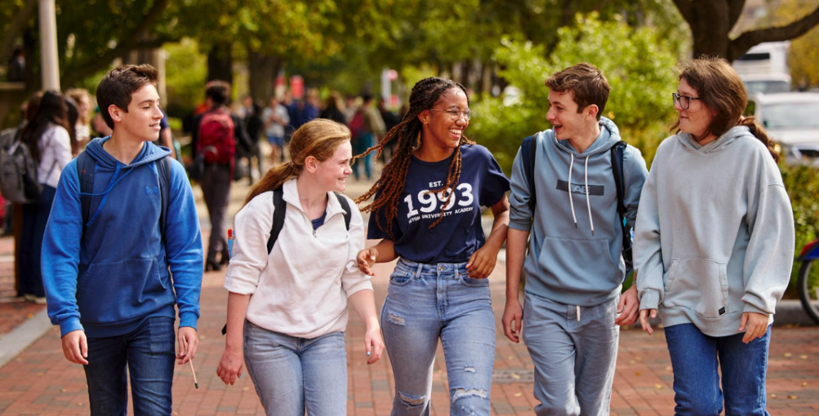
Thank you for your leadership!
Reach out or stop by for guidance or to ask questions

