Slide 1




STUDENT ORGANIZATION BUDGET REQUEST ORIENTATION
Understanding Eligibility, Priorities, and Procedures

Slide 2


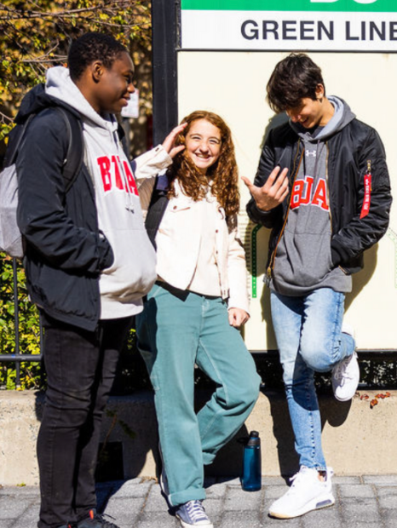
ELIGIBILITY
REQUIREMENTS
In order to submit a budget request your group must...
  be officially approved through the registration process
  have a faculty advisor to approve purchases
  score 100% on the budget policy quiz (all leaders)

Slide 3





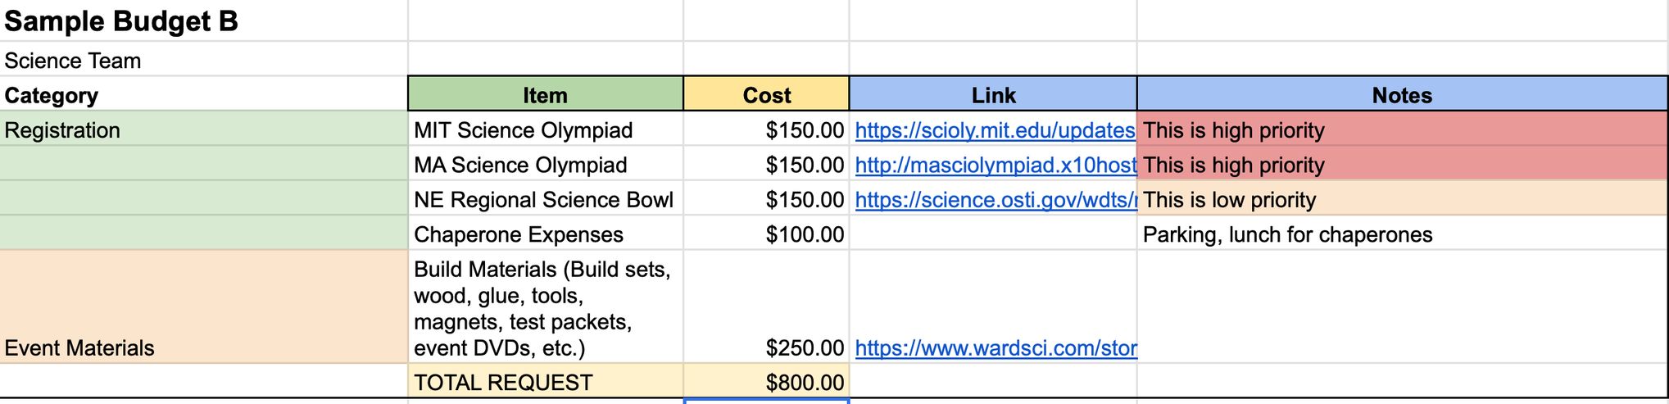
BUDGET REQUEST EXAMPLE
Fund what your club needs to operate and achieve its mission
ESSENTIAL
LOWER PRIORITY
Nice-to-have requests like additional conferences or non-essential materials
Reminder Food purchases are allowed only for special events, not regular meetings
Notes:
List your anticipated expenses at the start of the year and let me know throughout the year when you need the purchases made. I will not make a purchase when budgets are approved. I will make a purchase when you follow the next steps for requesting a purchase.

Slide 4




HOW TO REQUEST
A PURCHASE
01
Email a link to the desired item and CC your faculty advisor for approval confirmation.
02
Ms. Perrone reviews and places the order in the advisor’s name
03
You will be notified when the order is placed and when you can expect delivery
04
The purchase amount will be deducted from your budget on Club Hub.
Notes:
This applies for items as well as conference/competition registration and food purchases. In some cases, your advisor may make purchases and they should add the expense into club hub.
on rare occasions may a student make a purchase themselves. i will explain

Slide 5


REIMBURSEMENT RULES
On rare occasions, students may make purchases after receiving prior approval.
If you're allowed to purchase on your own, save your receipt and submit it to Ms. Perrone.
Reimbursements typically take about two weeks to process once submitted.

Slide 6



PRIZE
RESTRICTIONS
GIFT CARD
Gift cards are not allowed to be purchased for prizes.
Notes:
some clubs hold events with prizes, yay! however gift cards are not allowed to be purchased per BU policy. If gift cards are donated to a club, they may use that as a prize.

Slide 7

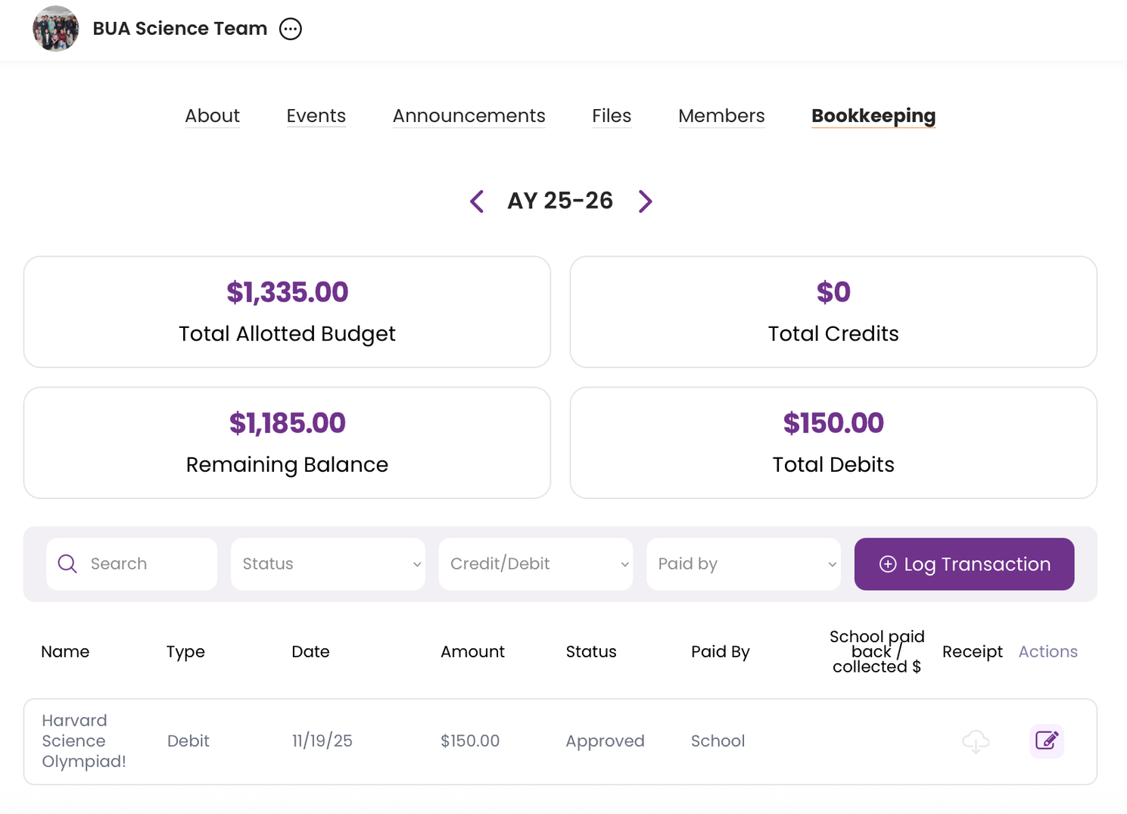
Club Hub
Notes:
see allotted budget, amount remaining, and each item you have purchase. If your advisor makes a purchase, they can log it here, too.
there is a pool of allotted money for student organization each year, once I assign money to a club at the end of the budget request period, no other requests may be made throughout the year. If a club is made in the middle of the year, it is unlikely you will be granted a budget as the money has already been allocated.
note - budgets do not roll over year to year. use it or lose it

Slide 8




NEXT STEPS
Pass the budget policy quiz (all leaders of your group)
Draft your budget request in collaboration with your faculty advisor.
Submit a budget through the same google form using the budget template provided.
Reach out with any questions.
Notes:
Policy Quiz and submission Link
https://docs.google.com/forms/d/e/1FAIpQLSf1qTeaXFsS86yd5eVjxwMjZvRCDDGO8qTePVKPziHV1kdlhQ/viewform?usp=header

